Slide 1



PARIVEDANA PORTAL
Grievances Portal
By Chhaya Chaudhary

Slide 2
Why I chose this grievances portal
To provide a centralized platform for addressing grievances in various sectors.
To improve communication and collaboration between users and concerned authorities.
To enhance transparency and accountability in grievance resolution.

Slide 3
Introduction
In today's world, there are many instances where people face problems and have no platform to voice their concerns. PRIVEDANA aims to solve this problem by providing a digital platform where individuals can file their complaints and track their status online

Slide 4
Objective
To provide a platform for individuals to file their complaints and track their status online
To streamline the communication between the users and administrators for efficient grievance redressal
To ensure timely and effective resolution of complaints
To maintain transparency and accountability in the grievance redressal process

Slide 5
Project Overview
The PRIVEDANA grievances portal is built using the MERN stack.
MERN stands for MongoDB, Express.js, React.js, and Node.js.
MongoDB is used for database management, while Express.js and Node.js are used for server-side programming.
React.js is used for building the user interface and for handling user interactions.
The MERN stack is a popular and powerful combination for building web applications, and provides scalability and flexibility for future development.

Slide 6
Technology Stack
PRIVEDANA allows users to file their complaints easily and efficiently.
Users can access the portal through any device with an internet connection.
The portal has a user-friendly interface that makes it easy for users to navigate and file their complaints.
Users can also check the status of their complaints and receive updates in real-time.
The portal is secure and confidential, and users' personal information is protected.

Slide 7
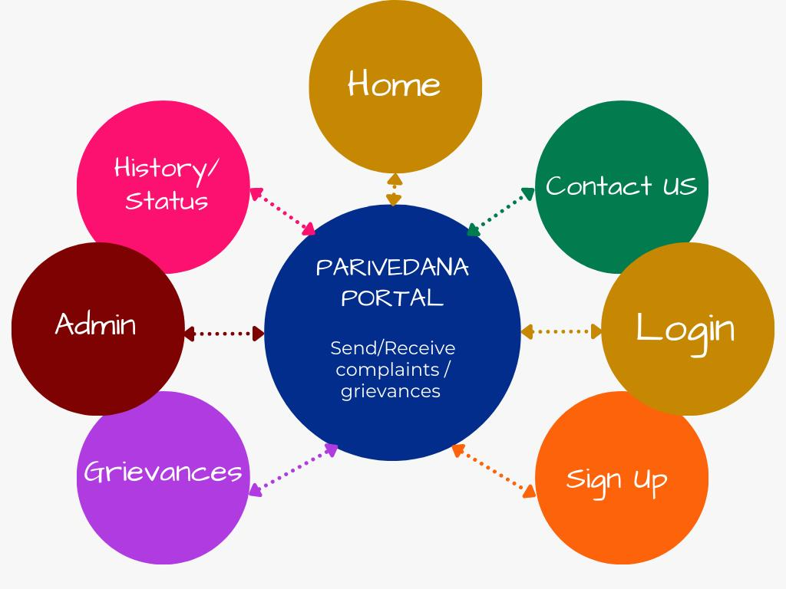
Data Flow Diagram

Slide 8
Conclusion
PRIVEDANA is a powerful and user-friendly grievances portal.
It provides a platform for people to file complaints and get updates on their status.
The MERN stack used for building this portal ensures a seamless experience for both users and admins.
PRIVEDANA prioritizes transparency, accountability, and efficiency in addressing grievances.
With PRIVEDANA, people can voice their concerns and have them resolved in a timely and effective manner.
This portal is a step towards a more accountable and responsive society.

Slide 9
Some snapshots of Parivedana Portal

Slide 10
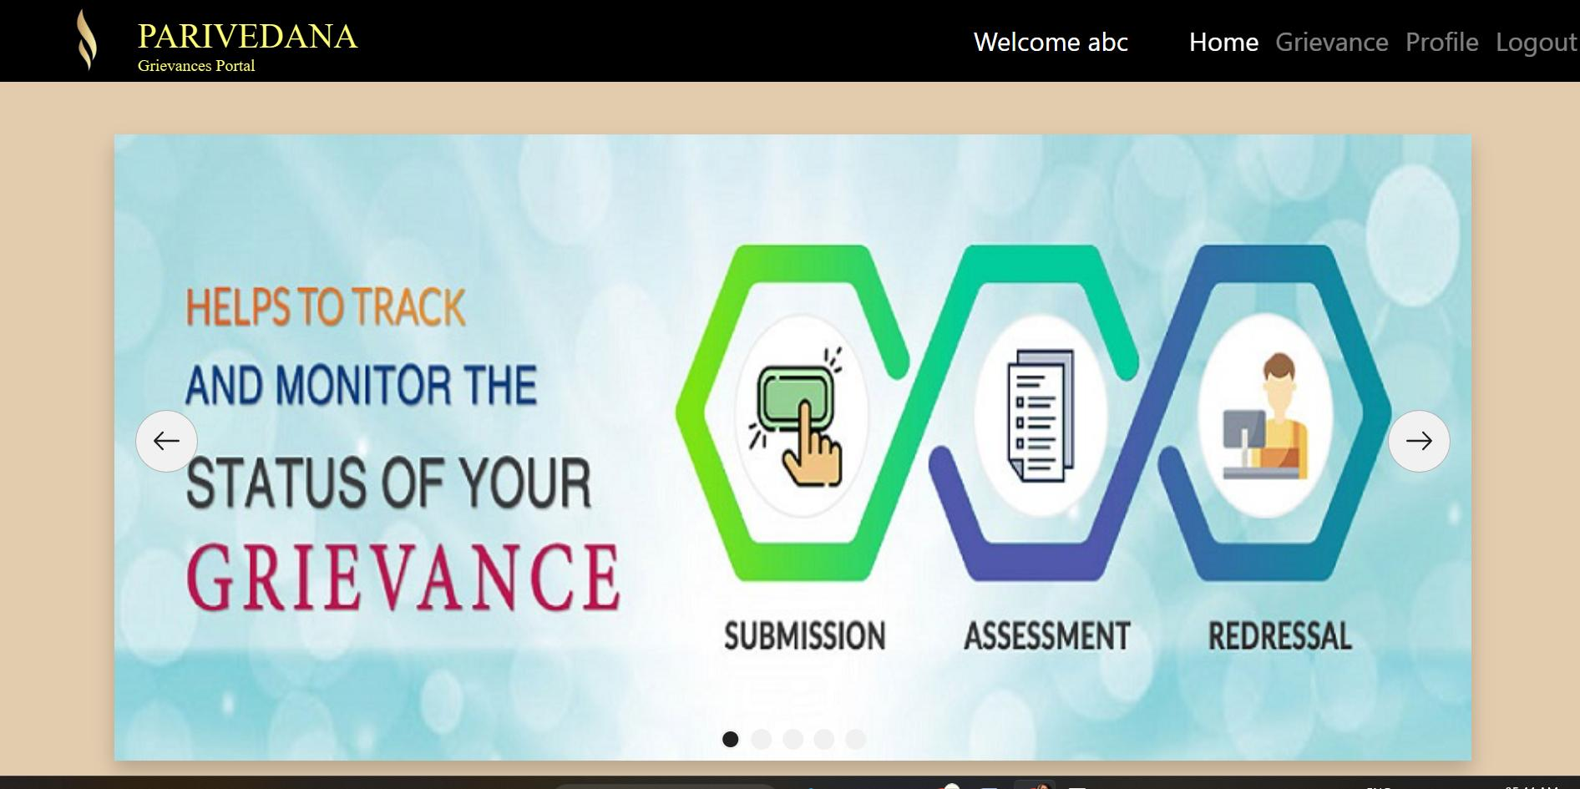
Home Page

Slide 11
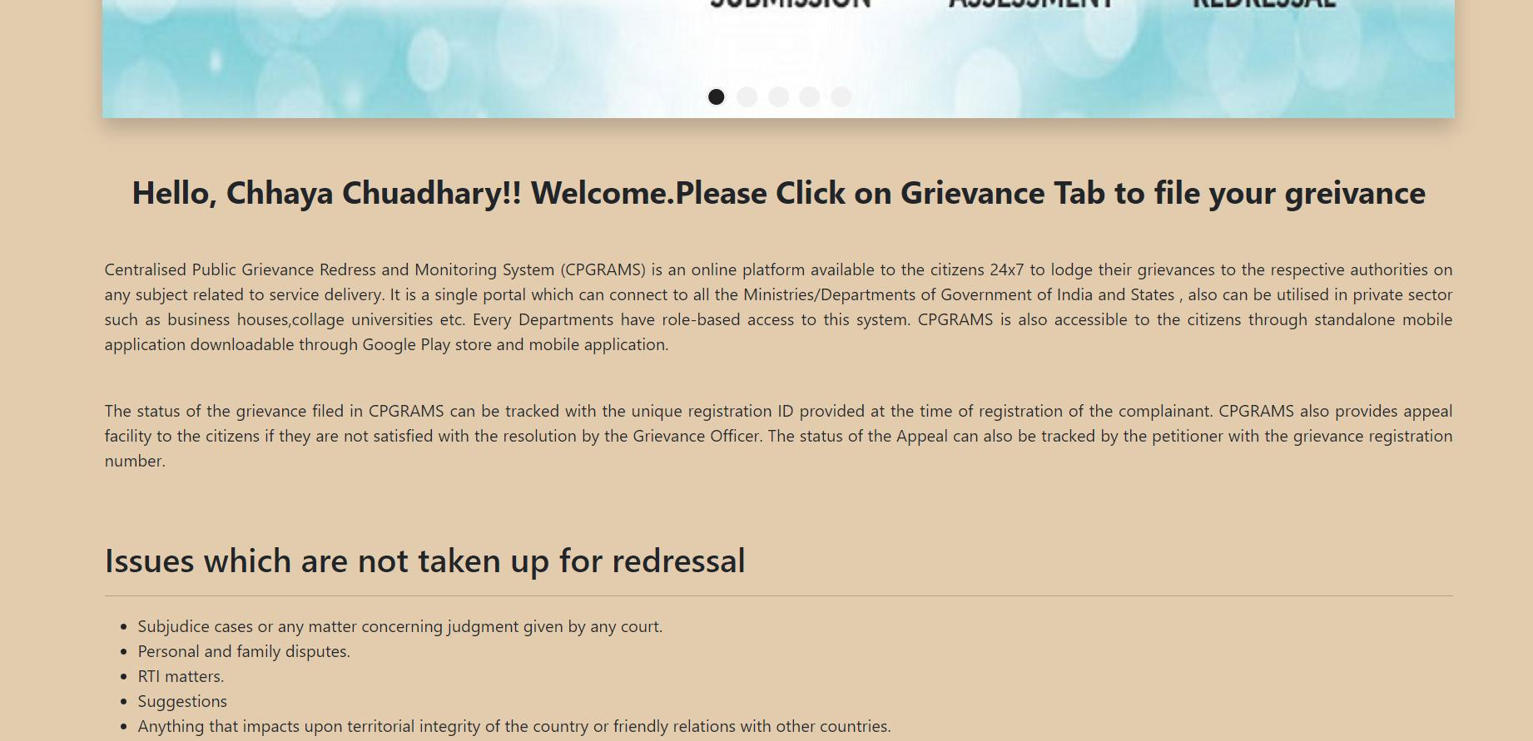

Slide 12
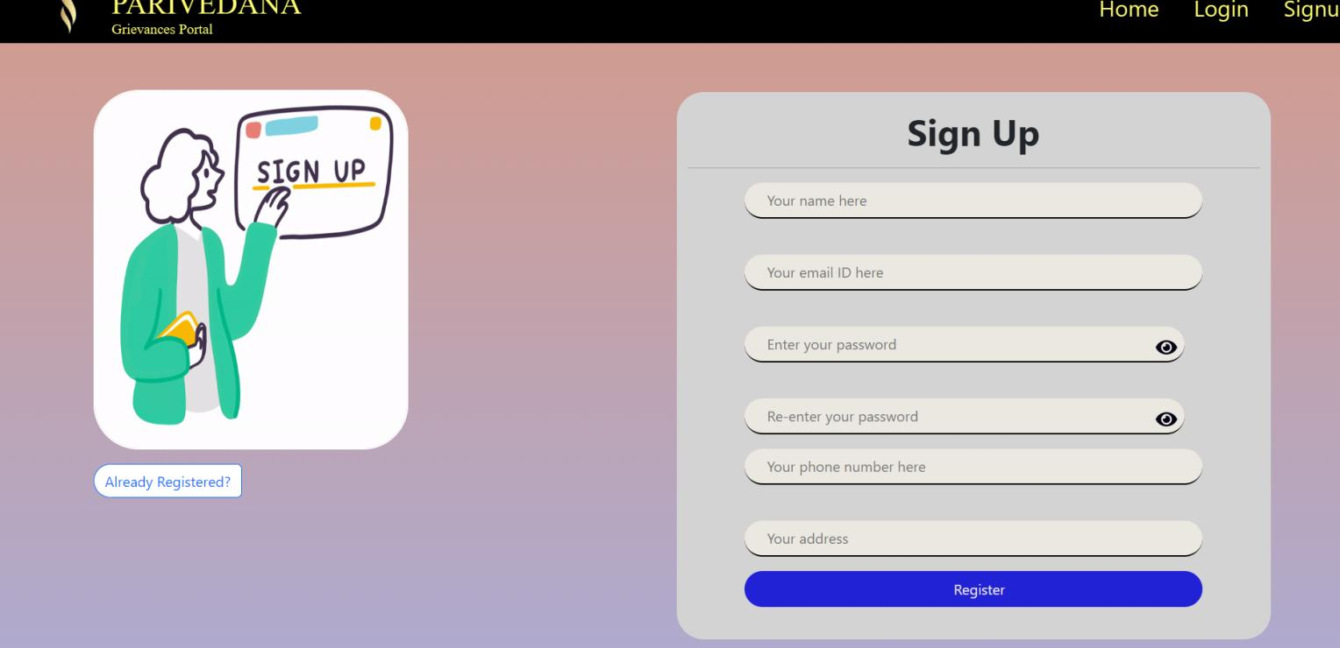
SignUp

Slide 13
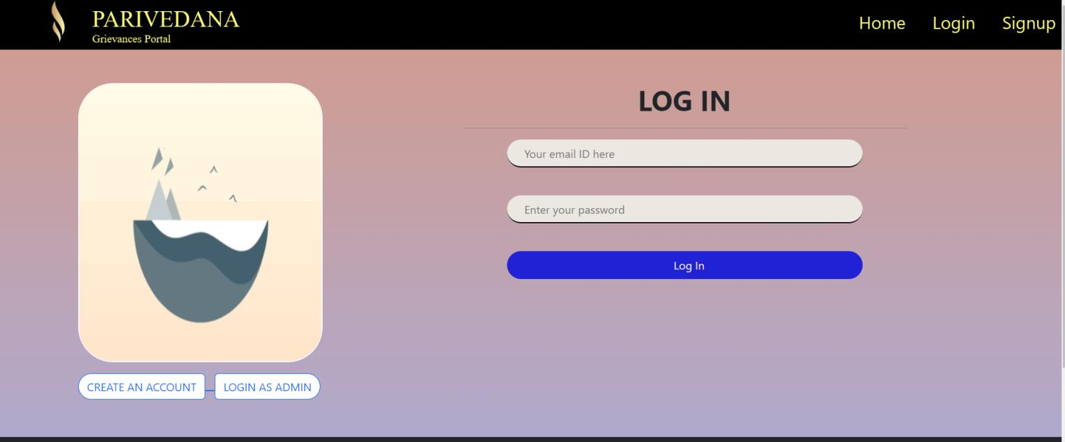
Login

Slide 14
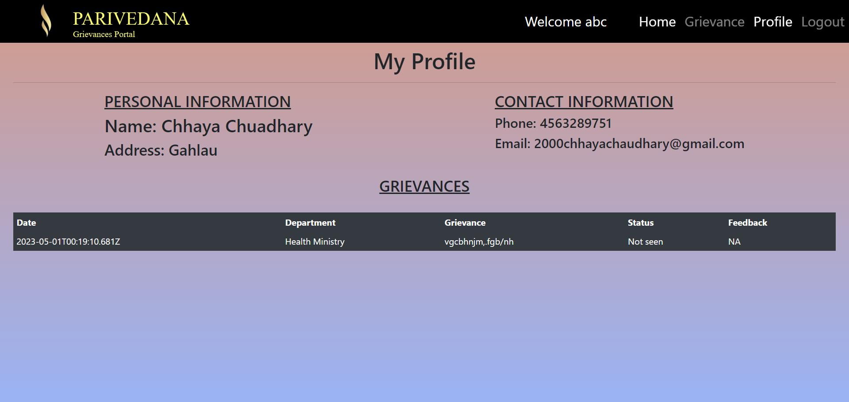
Profile

Slide 15
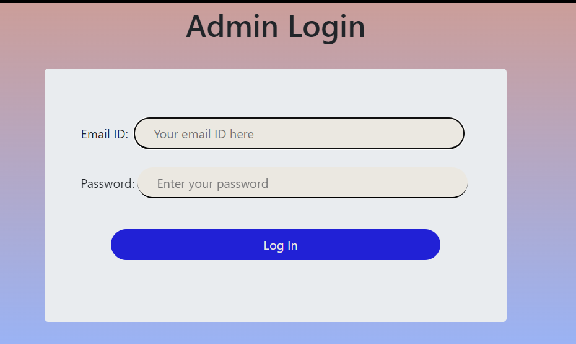
Admin Login

Slide 16
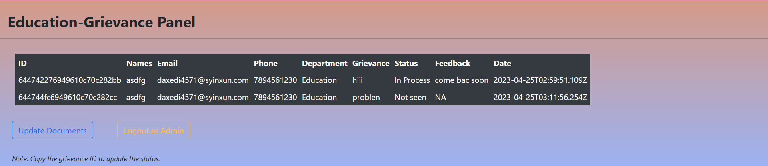
All Grievances

Slide 17
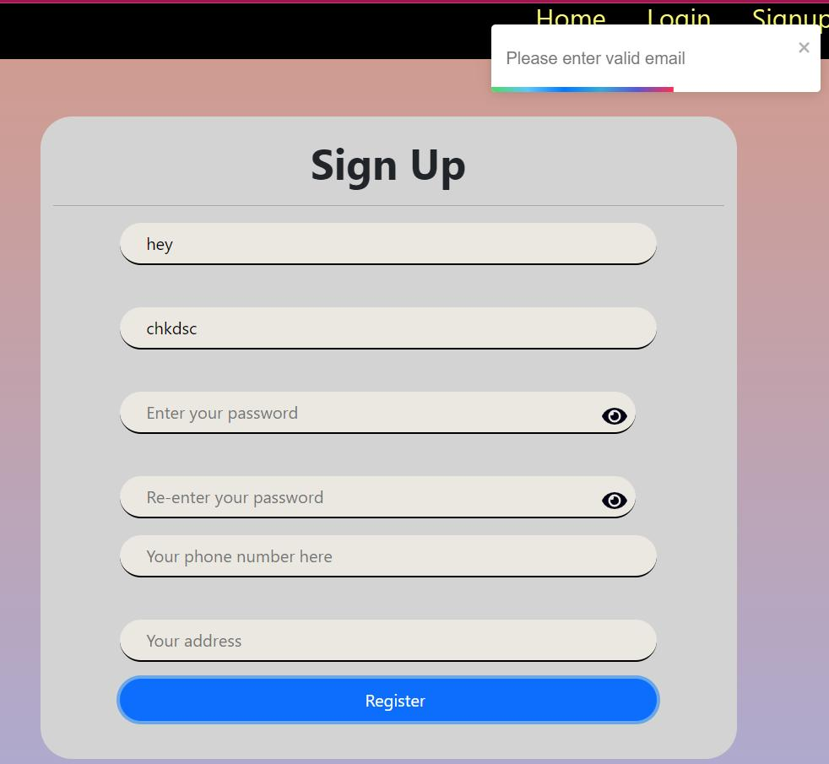
Notification

Slide 18
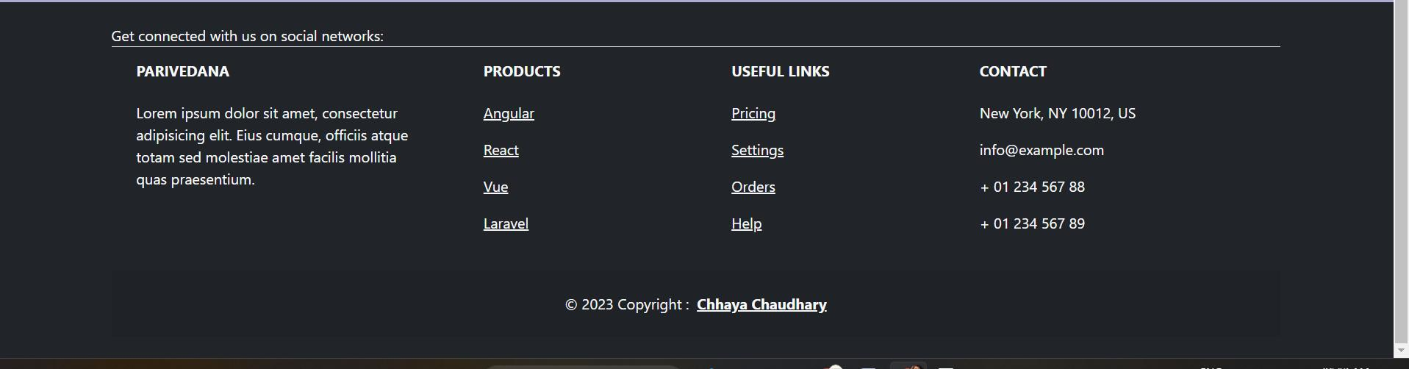
Footer

